Slide 1
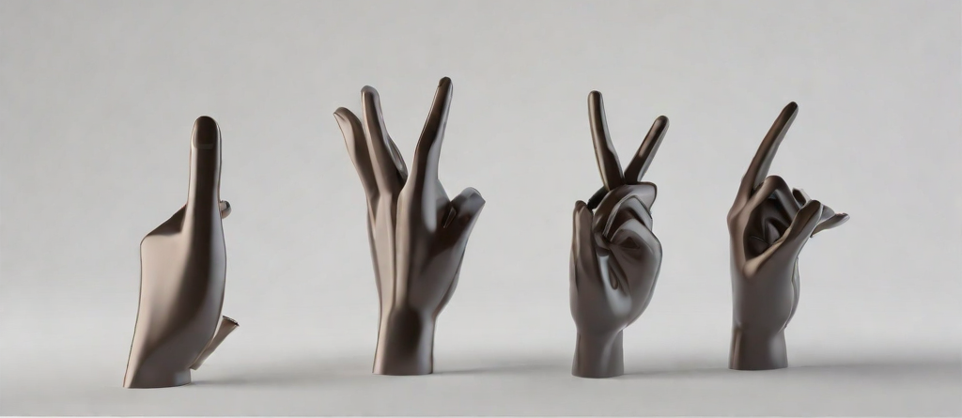
Team - AI Architects
Sign Language Recognizer
- A Seamless Solution for the Hearing Impaired
Akshitha Pattapu
Sai Pranay Ganta
Kakarla Meghana
Sampangi Venkata Manikanta

Slide 2
Abstract
The Sign Language Recognizer project pioneers a cutting-edge real-time American Sign Language (ASL) detection system, merging OpenCV for image capture, MediaPipe for precise hand tracking, and a Random Forest classifier for robust model training.
Its core mission is to enhance accessibility for the hearing impaired by providing a responsive platform for ASL communication through standard webcams.
By leveraging machine learning and computer vision, the system interprets intricate hand movements into recognizable symbols in real-time, promising inclusive communication environments and fostering engagement in daily life.

Slide 3
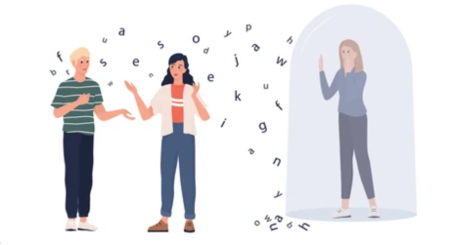
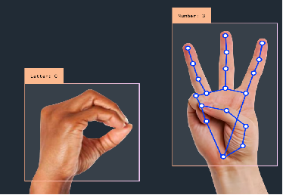
Introduction
466 million people suffer from hearing loss worldwide.
A groundbreaking project introduces a real-time American Sign Language (ASL) detection system.
This innovation aims to break communication barriers for the hearing impaired.
Inclusive communication: Fostering a future where every voice, including sign language, is valued and uplifted.
Belonging for all: Envisioning a world where inclusivity reigns, empowering individuals to thrive and belong without bounds.

Slide 4
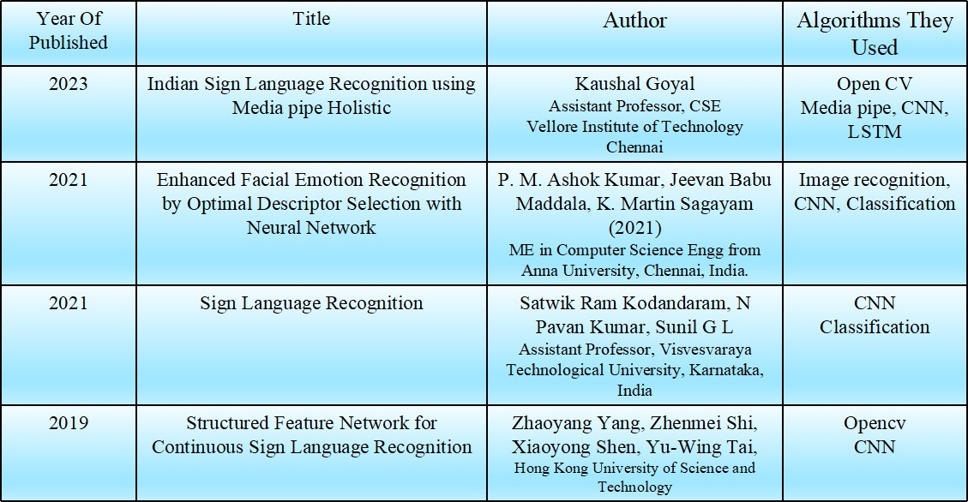
Literature Survey

Slide 5
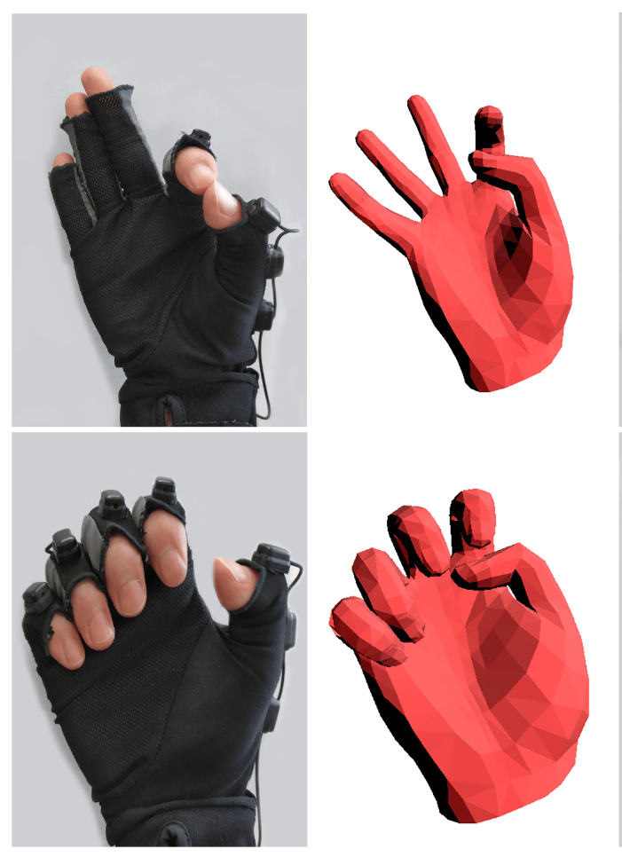
Existing Methodology
Recognizing hand gestures in the field of machine learning poses challenges, categorized into supervised methods for classification.
In 1991, Murakami and Taguchi introduced neural networks for sign language recognition, marking an early milestone.
Wang and Popovic developed a real-time hand tracking application using colored gloves, recognized by the K-Nearest Neighbors (KNN) technique.

Slide 6
Proposed System
Capturing of Images
Dataset Creation
Assigning The Target Class
Classify the Signs from a
Video Stream
Load the Model
Train and Save the Model

Slide 7
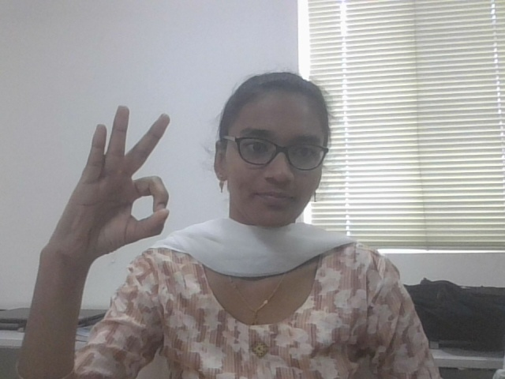
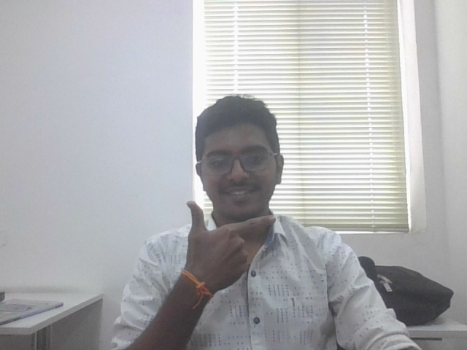
Workflow
1. Data Collection:
Captured Images:
The capture_images.py to capture images of different hand gestures from a camera.
Organize images into folders based on gesture classes.
Created Dataset:
The create_dataset.py to:
Extract hand landmarks from images using MediaPipe.
Normalize coordinates for consistency.
Store hand landmarks and corresponding labels in a pickle file.

Slide 8
2. Model Training:
Train Model:
The training.py to:
Load the dataset from the pickle file.
Split data into training and testing sets.
Train a Random Forest classifier to recognize hand gestures.
Evaluate model accuracy on the testing set.
Save the trained model to a pickle file.
Load Model:
The classifier.py to:
Load the trained model from the pickle file.
Initialize video capture from a camera.
Set up MediaPipe for hand landmark detection.

Slide 9
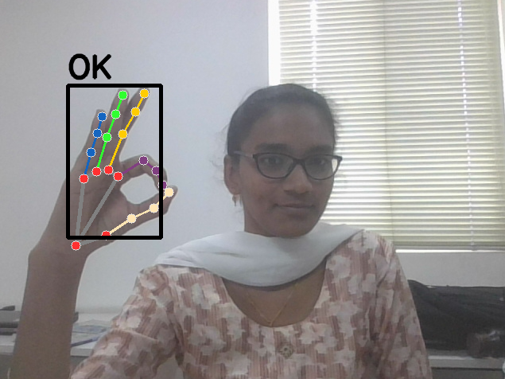
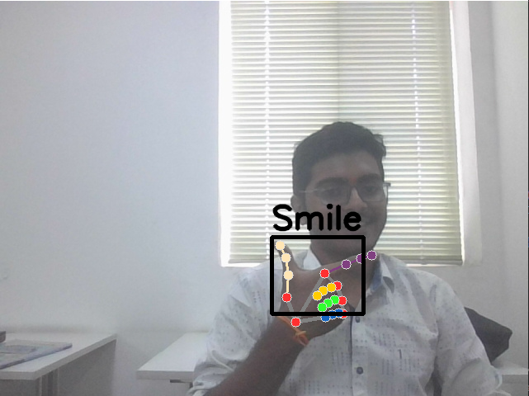
3. Real-Time Recognition
Recognize Gestures:
Continuously capture frames from the camera.
Detect hands in each frame using MediaPipe.
Extract hand landmarks for detected hands.
Normalize coordinates as done during dataset creation.
Use the trained model to predict the gesture class for each hand.
Draw bounding boxes and predicted labels around hands on the video frame.
Display the annotated video in real-time.

Slide 10
Technical Stack
1. Programming Languages: Python.
2. Libraries and Frameworks:
OpenCV (cv2): For real-time video capture, image processing, and display.
MediaPipe: For hand landmark detection and tracking.
scikit-learn: For machine learning algorithms, specifically Random Forest classifier.
NumPy: For numerical computations and array manipulation.
Pickle: For saving and loading datasets and trained models.

Slide 11
Future Scope
1. Enhance recognition capabilities:
Expand the recognized gestures: Include more sign language signs and gestures.
Recognize continuous signs: Understanding sequences of signs to form words and sentences.
2. Improve user experience:
Multi-user support: Recognize and differentiate between gestures from multiple people in a scene.
Speech synthesis: Convert recognized sign language into spoken language for better accessibility.
Personalized customization: Allow users to train the model on their own signs or preferred variations.

Slide 12
3. Integration and applications:
Mobile app development: Create a mobile app version for sign language communication on the go.
Video conferencing integration: Enhance video conferencing platforms with real-time sign language translation.
Educational tools: Develop sign language learning apps and gamified experiences for children and adults.
Accessibility tools: Integrate the technology into public spaces and devices to improve communication accessibility for deaf and hard-of-hearing individuals.

Slide 13
Conclusion
We have developed real-time Sign Language Recognizer using accessible tools.
It is a three-step process: data collection, model training, real-time recognition.
We have demonstrated a promising potential output and future enhancements include expanded gestures.
The user experience improvements like multi-user support and personalized customization planned.
The project has a greater Potential for broader impact through integration into mobile apps and educational tools, promoting inclusivity.

Slide 14




www.hexart.in
Sponsored by
THANK YOU
CSR Partner
Implementation Partner

